Slide 1
JavaScript
Precursor to React

Slide 2
var vs let vs const
var is function scoped and it can be re-declared and updated
var greeter = "hey hi";
var times = 4;
if (times > 3) {
var greeter = "say Hello instead";
}
console.log(greeter) // "say Hello instead"
Notes:
https://www.freecodecamp.org/news/var-let-and-const-whats-the-difference/

Slide 3
var vs let vs const
var is replaced by let which is block scoped
let greeting = "say Hi";
let times = 4;
if (times > 3) {
let hello = "say Hello instead";
console.log(hello);// "say Hello instead"
}
console.log(hello) // hello is not defined
Notes:
https://www.freecodecamp.org/news/var-let-and-const-whats-the-difference/

Slide 4
var vs let vs const
let can be updated but not re-declared.
Just like var, a variable declared with let can be updated within its scope. Unlike var, a let variable cannot be re-declared within its scope. So while this will work:
let greeting = "say Hi";
greeting = "say Hello instead";
this will return an error:
let greeting = "say Hi";
let greeting = "say Hello instead"; // error: Identifier 'greeting' has already been declared
Notes:
https://www.freecodecamp.org/news/var-let-and-const-whats-the-difference/

Slide 5
var vs let vs const
let - if the same variable is defined in different scopes using let, there will be no error:
let greeting = "say Hi";
if (true) {
let greeting = "say Hello instead";
console.log(greeting); // "say Hello instead"
}
console.log(greeting); // "say Hi"
Why is there no error? This is because both instances are treated as different variables since they have different scopes.
This fact makes ‘let’ a better choice than ‘var’. When using ‘let’, you don't have to bother if you have used a name for a variable before as a variable exists only within its scope.
Also, since a variable cannot be declared more than once within a scope, then the problem discussed earlier that occurs with var does not happen.

Slide 6
var vs let vs const
Hoisting of let : - Just like var, let declarations are hoisted to the top.
Unlike var which is initialized as undefined, the let keyword is not initialized.
So if you try to use a let variable before declaration, you'll get a Reference Error.

Slide 7
var vs let vs const
Const :- Variables declared with the const maintain constant values. const declarations share some similarities with let declarations.
const declarations are block scoped
const cannot be updated or re-declared
Every const declaration, therefore, must be initialized at the time of declaration.
While a const object cannot be updated, the properties of this object can be updated
Just like let, const declarations are hoisted to the top but are not initialized. So if you try to use a const variable before declaration, you'll get a Reference Error.

Slide 8
var vs let vs const
const greeting = {
message: "say Hi",
times: 4
}
we can’t do this:
greeting = {
words: "Hello",
number: "five"
} // error: Assignment to constant variable.
we can do this:
greeting.message = "say Hello instead";
//This will update the value of greeting.message without returning errors.

Slide 9
var vs let vs const
let and const basically replace var .
You use let instead of var.
You use const instead of var if you plan on never re-assigning this "variable" (effectively turning it into a constant therefore).

Slide 10
Arrow functions
Arrow functions were introduced in ES6.
Arrow functions allow us to write shorter function syntax:
let myFunction = (a, b) => a * b;
Traditional function
hello = function() { return "Hello World!"; }
With arrow function
const hello = () => {
return "Hello World!";
}

Slide 11
Arrow function
The handling of this is also different in arrow functions compared to regular functions.
In regular functions the this keyword represented the object that called the function, which could be the window, the document, a button or whatever.
With arrow functions the this keyword always represents the object that defined the arrow function.
In short, with arrow functions there are no binding of this.
Remember these differences when you are working with functions. Sometimes the behavior of regular functions is what you want, if not, use arrow functions.
Notes:
https://www.w3schools.com/js/js_arrow_function.asp

Slide 12
Arrow Functions
When having no arguments, you have to use empty parentheses in the function declaration:
const callMe = () => {
console.log('Max!');
}
When having exactly one argument, you may omit the parentheses:
const callMe = name => {
console.log(name);
}
When just returning a value, you can use the following shortcut:
const returnMe = name => name

Slide 13
Exports & Imports
In React projects (and actually in all modern JavaScript projects), you split your code across multiple JavaScript files - so-called modules.
You do this, to keep each file/module focused and manageable.
To still access functionality in another file, you need export (to make it available) and import (to get access) statements.
You got two different types of exports: default (unnamed) and named exports:
default => export default ...;
named => export const someData = ...;
You can import default exports like this:
import smNameOfYrChoice from './path/to/file.js’; (Surprisingly, smNameOfYrChoice is totally up to you.)
Named exports have to be imported by their name:
import { someData } from './path/to/file.js';

Slide 14
Export and Imports
A file can only contain one default and an unlimited amount of named exports.
You can also mix the one default with any amount of named exports in one and the same file.
When importing named exports, you can also import all named exports at once with the following syntax:
import * as mybook from './path/to/mybookjs’;
mybook simply bundles all exported variables/functions in one JavaScript object.
For example, if you export const someData = ... (/path/to/mybook.js ) you can access it on mybook like this: mybook.someData .

Slide 15
Classes
Classes are a feature which basically replace constructor functions and prototypes.
You can define blueprints for JavaScript objects with them.
class Person {
name = 'Max’;
printMyName = () => { console.log(this.name); }
}
const person = new Person();
person.printMyName();

Slide 16
Inheritance
printMyName = () => {
console.log('this is '+this.species+" with name "+this.name);
}
}
const person = new Person('Human’, 'Namrata’);
person.printMyName();
console.log(person.species);
Output:-
this is Human with name Namrata
Human
class Human {
species = 'human';
constructor(species)
{
this.species = species;
}
}
class Person extends Human {
constructor(species, name)
{
super(species);
this.name = name;
}

Slide 17
The spread operator
The spread operator is extremely useful for cloning arrays and objects.
With the spread operator you have an easy way of creating a (shallow!) clone of the object or array.
const arr = [1, 2, 3];
const arr1 = [...arr, 4, 5]
console.log(arr1);
const oldobj = {
name: 'nama'
}
const newobj = {
...oldobj,
age:40
}
console.log(newobj);
Output:
[ 1, 2, 3, 4, 5 ]
{ name: 'nama', age: 40 }

Slide 18
Destructuring
Destructuring allows you to easily extract and access the values of arrays or objects and assign them to variables.
const arr = [1,2];
const [no1,no2] = arr;
console.log(no1);
console.log(no2);
const person = {
myname:'namrata',
myage:41
}
const {myname} = person;
console.log(myname);
//console.log(myage); --gives error

Slide 19
Destructuring
//destructuring while calling a function
const func=
({age})=>{console.log(age)};
func({myname:'nisha',age:40});
//destructuring while returning an object
const func2 = ()=>{
return{ myname:'nima',
myage:41,
mygender:'female’
};
}
const {myage,mygender} = func2();
console.log(myage+','+mygender);

Slide 20
Array find element and element’s index
let arr = ['a','b','c’];
let e = arr.find(ele => ele=='c’);
console.log(e);
let loc = arr.findIndex(ele => ele=='c’);
console.log("index of ele 'c' in array
is:"+loc);
let books = [{id:1,name:'b1’},
{id:2,name:'bk2’},
{id:3,name:'bk3'}];
const mybook = books.find(b => b.id==2);
console.log(mybook);
const pos = books.findIndex(b => b.id==2);
console.log("index of an book in array with
bookid 2 is "+pos);

Slide 21
Async and Await
Use of async and await enables the use of ordinary try / catch blocks around asynchronous code.
Use of await is valid only inside async function
Use of async and await enables the use of ordinary try / catch blocks around asynchronous code.
async function getreq() {
try
{
const result = await
fetch("http://localhost:8081/getemp1/22");
console.log(result.status);
if(!result.ok)
throw 'get request failed: response status
is:'+result.status;
const emp = await result.json();
console.log(emp);
}
catch(error)
{
console.log('get request failed:'+error);
}
}
getreq();
Notes:
https://developer.mozilla.org/en-US/docs/Web/JavaScript/Reference/Statements/async_function

Slide 22
React
Notes:
https://github.com/academind/react-complete-guide-code/tree/03-react-basics-working-with-components/code

Slide 23
What is React?
React is a JavaScript library for building user interfaces.

Slide 24
How does React Work?
React creates a VIRTUAL DOM in memory.
Instead of manipulating the browser's DOM directly, React creates a virtual DOM in memory, where it does all the necessary manipulating, before making the changes in the browser DOM.
React only changes what needs to be changed!

Slide 25
Why React?
React makes building complex, interactive and reactive user interfaces simpler

Slide 26
Create React App
Create React App is a comfortable environment for learning React, and is the best way to start building a new single-page application in React.

Slide 27
Create-React-App
https://create-react-app.dev/docs/getting-started
npx create-react-app app1
cd app1
npm start
It sets up your development environment so that you can use the latest JavaScript features, provides a nice developer experience, and optimizes your app for production.
You’ll need to have Node >= 14.0.0 and npm >= 5.6 on your machine.
Notes:
Create React App doesn’t handle backend logic or databases; it just creates a frontend build pipeline, so you can use it with any backend you want. Under the hood, it uses Babel and webpack.
When you’re ready to deploy to production, running npm run build will create an optimized build of your app in the build folder.
Why Babel is used in react?
Babel enables React developers to use the latest JavaScript syntax in their components. Babel transpiles modern JavaScript for use in React components and all browsers. Babel ensures code compatibility across all browsers by transpiling modern JavaScript.
What is webpack and why use it?
Webpack is a static module bundler for JavaScript applications — it takes all the code from your application and makes it usable in a web browser. Modules are reusable chunks of code built from your app's JavaScript, node_modules, images, and the CSS styles which are packaged to be easily used in your website.
ESlint is an open-source library that's commonly used by React developers to enforce rules about maintaining the code standard across the project. It's fully customizable so you can configure the desired rules yourself. Lininting your code can help you spot any would be bugs.

Slide 28
React.JS History
Current version of React.JS is V18.0.0 (April 2022).
Initial Release to the Public (V0.3.0) was in July 2013.
React.JS was first used in 2011 for Facebook's Newsfeed feature.
Facebook Software Engineer, Jordan Walke, created it.
Current version of create-react-app is v5.0.1 (April 2022).
create-react-app includes built tools such as webpack, Babel, and ESLint.

Slide 29
What is JSX?
JSX stands for JavaScript XML.
JSX makes it easier to write and add HTML in React.
JSX allows us to write HTML elements in JavaScript and place them in the DOM without any createElement() and/or appendChild() methods.
JSX converts HTML tags into react elements.

Slide 30
Using JSX
const root = ReactDOM.createRoot(document.getElementById('root'));
//root.render(<h1>Hello World All! </h1>);
const myElement = <h1>I Love JSX!</h1>;
root.render(myElement);
/*
//without JSX
const myElement1 = React.createElement('h1', {}, 'I do not use JSX!');
root.render(myElement1);
*/

Slide 31
What is JSX?
Consider this variable declaration:
const element = <h1>Hello, world!</h1>;
This tag syntax is neither a string nor HTML.
It is called JSX, and it is a syntax extension to JavaScript.
We recommend using it with React to describe what the UI should look like.
JSX may remind you of a template language, but it comes with the full power of JavaScript.
JSX produces React “elements”.

Slide 32
Why JSX?
React embraces the fact that rendering logic is inherently coupled with other UI logic: how events are handled, how the state changes over time, and how the data is prepared for display.
Instead of artificially separating technologies by putting markup and logic in separate files, React separates concerns with loosely coupled units called “components” that contain both.

Slide 33
JSX as an Expression
After compilation, JSX expressions become regular JavaScript function calls and evaluate to JavaScript objects.
This means that you can use JSX inside of if statements and for loops, assign it to variables, accept it as arguments, and return it from functions:
function getGreeting(user) {
if (user) {
return <h1>Hello, {formatName(user)}!</h1>;
}
return <h1>Hello, Stranger.</h1>;
}
Notes:
https://legacy.reactjs.org/docs/introducing-jsx.html

Slide 34
Using JSX as an attribute
You may use quotes to specify string literals as attributes:
const element = <a href="https://www.reactjs.org"> link </a>;
You may also use curly braces to embed a JavaScript expression in an attribute:
const element = <img src={user.avatarUrl}></img>;
Don’t put quotes around curly braces when embedding a JavaScript expression in an attribute. You should either use quotes (for string values) or curly braces (for expressions), but not both in the same attribute.

Slide 35
Expressions in JSX
With JSX you can write expressions inside curly braces { }.
The expression can be a React variable, or property, or any other valid JavaScript expression.
JSX will execute the expression and return the result:

Slide 36
Rendering an Element into the DOM
Let’s say there is a <div> somewhere in your HTML file:
<div id="root"></div>
We call this a “root” DOM node because everything inside it will be managed by React DOM.
Applications built with just React usually have a single root DOM node. If you are integrating React into an existing app, you may have as many isolated root DOM nodes as you like.
To render a React element,
1) first pass the DOM element to ReactDOM.createRoot()
2) then pass the React element to root.render():
const root = ReactDOM.createRoot(
document.getElementById('root')
);
const element = <h1>Hello, world</h1>;
root.render(element);

Slide 37
Rendering an Element into the DOM
Updating the Rendered Element :- React elements are immutable.
Once you create an element, you can’t change its children or attributes.
An element is like a single frame in a movie: it represents the UI at a certain point in time.
The only way to update the UI is to create a new element, and pass it to root.render().

Slide 38
React is all about Components?

Slide 39
What is a Component?

Slide 40
What is a Component?

Slide 41
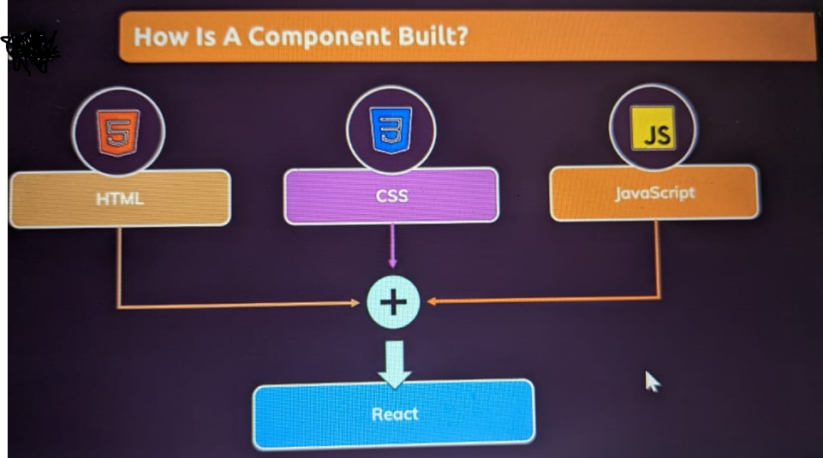

Slide 42
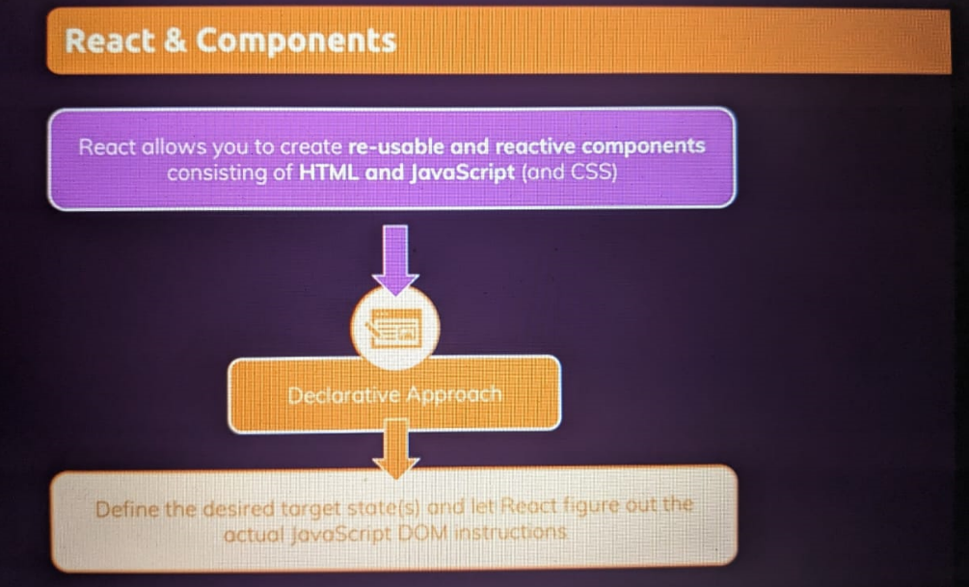

Slide 43
What is a Component?
Build your own, custom HTML elements.

Slide 44
What is a Component?
Components let you split the UI into independent, reusable pieces, and think about each piece in isolation.
Conceptually, components are like JavaScript functions.
They accept arbitrary inputs (called “props”) and return React elements describing what should appear on the screen.

Slide 45
Function and Class Components
The simplest way to define a component is to write a JavaScript function:
function Welcome(props) {
return (<h1>Hello, {props.name}</h1>);
}
Note: can omit round-bracket of return if it has only one statement
This function is a valid React component because it accepts a single “props” (which stands for properties) object argument with data and returns a React element.
We call such components “function components” because they are literally JavaScript functions.

Slide 46
Function and Class Components
You can also use an ES6 class to define a component:
import React from 'react’;
class Welcome extends React.Component {
render() {
return (<h1>Hello, {this.props.name}</h1>);
}
}
The (earlier and above) two components are equivalent from React’s point of view.

Slide 47
Component state
Any component can have it’s own internal state.
state is often called local or encapsulated.
It is not accessible to any component other than the one that owns and sets it.
props is immutable/readonly but state is mutable.
A component may choose to pass its state down as props to its child components

Slide 48
Stateful and Stateless Components
State generally refers to data or properties that need to be tracking in an application.
In React, a stateful component is a component that holds some state. Stateless components, by contrast, have no state.
Note that both types of components can use props.
In the example, there are two React components. The Store component is stateful and the Week component is stateless.
class Week extends React.Component {
render() {
return <h1>Today is {this.props.day}!</h1>;
}
}
class Store extends React.Component {
constructor(props) {
super(props);
this.state = { sell: 'anything' };
}
render() {
return <h1>I'm selling {this.state.sell}.</h1>;
}
}

Slide 49
Stateful and Stateless Components
The React useState Hook allows us to track state in a function component.
To use the useState Hook, we first need to import it into our component.
Initialize useState - We initialize our state by calling useState in our function component.
useState accepts an initial state and returns two values:
The current state.
A function that updates the state.
Update State - To update our state, we use our state updater function.
We should never directly update state. Ex: color = "red" is not allowed.
import { useState } from "react";
import ReactDOM from "react-dom/client";
function FavoriteColor() {
const [color, setColor] = useState("red");
return (
<>
<h1>My favorite color is {color}!</h1>
<button type="button"
onClick={ () => setColor("blue") }
>Blue</button>
</>
)
}
export default FavoriteColor;
Note: color, setColor - These names are variables that can be named anything you would like.

Slide 50
Stateful Components
The useState Hook can be used to keep track of strings, numbers, booleans, arrays, objects, and any combination of these!
We could create multiple state Hooks to track individual values Or, we can just use one state and include an object instead!

Slide 51
Stateful Component – UseState hook
const [brand, setBrand] = useState("Ford");
const [model, setModel] = useState("Mustang");
const [year, setYear] = useState("1964");
const [color, setColor] = useState("red");
return (
<>
<h1>My {brand}</h1>
<p>
It is a {color} {model} from {year}.
</p>
<button type="button"
onClick={()=> {
setColor("blue");
setYear("2000");
}
}
> change color and year</button>
</>
)
}
Notes:
https://www.w3schools.com/react/react_usestate.asp

Slide 52
Stateful Component – UseState hook
function Car(props) {
// const c = props.car;
const c = {
brand: "Ford",
model: "Mustang",
year: "1964",
color: "red"
}
const [car, setCar] = useState(c);
const updateColor = () => {
setCar(previousState => {
return { ...previousState, color: "blue" }
});
}
return (
<>
<h1>My {car.brand}</h1>
<p>
It is a {car.color} {car.model} from {car.year}.
</p>
<button
type="button"
onClick={updateColor}
>Blue</button>
</>
)
}
Notes:
https://www.w3schools.com/react/react_usestate.asp

Slide 53
What are stateless components in React?
React component with internal state is called Stateful component and React component without any internal state management is called Stateless component.
React recommends to create and use as many stateless component as possible and create stateful component only when it is absolutely necessary.

Slide 54
React Events
Just like HTML DOM events, React can perform actions based on user events.
React has the same events as HTML: click, change, mouseover etc.
Adding Events
React events are written in camelCase syntax:
onClick instead of onclick.
React event handlers are written inside curly braces:
onClick={shoot} instead of onClick="shoot()".
React:
<button onClick={shoot}>Take the Shot!</button>
HTML:
<button onclick="shoot()">Take the Shot!</button>

Slide 55
React Events
function Football() {
const shoot = () => {
alert("Great Shot!");
}
return (
<button onClick={shoot}>
Take the shot!
</button>
);
}
Passing Arguments
To pass an argument to an event handler, use an arrow function:-
function Football() {
const shoot = (a) => {
alert(a);
}
return (
<button onClick={ () => shoot("Goal!") }>
Take the shot!
</button>
);
}

Slide 56
React Events
React Event Object
Event handlers have access to the React event that triggered the function.
In our example the event is the "click" event.
function Football() {
const shoot = () => {
alert("Great Shot!");
}
return (
<button onClick={shoot}>
Take the shot!
</button>
);
}
Passing Arguments
To pass an argument to an event handler, use an arrow function:-
function Football() {
const shoot = (a) => {
alert(a);
}
return (
<button onClick={ () => shoot("Goal!") }>
Take the shot!
</button>
);
}

Slide 57
Conditional Rendering
Using if condition
Using && operator
function Garage(props)
{
const car = props.car;
return(
<>
<h3>Garage</h3>
{car.length>0 && <p>There are {car.length} cars in my garage!</p>}
</>
);
}
function Goal(props)
{
const isGoal = props.isGoal;
if( isGoal )
{ return <MadeGoal/>; }
return <MissedGoal/>;
}
Using Ternary (?:) operators
function Goal(props)
{
return(
<>
{ props.isGoal ? : <MadeGoal/> : <MissedGoal/> }
</>
) ;
}

Slide 58
React List
In React, you will render lists with some type of loop.
The JavaScript map() array method is generally the preferred method.
Keys
Keys allow React to keep track of elements. This way, if an item is updated or removed, only that item will be re-rendered instead of the entire list.
Keys need to be unique to each sibling. But they can be duplicated globally.
Generally, the key should be a unique ID assigned to each item. As a last resort, you can use the array index as a key.

Slide 59
Iterating through Lists
function Car1(props)
{
return(
<li> { props.brandname } </li>
);
}
function CarList1(props)
{
const carlist = [
{id:1,name:'Santro'},
{id:2,name:'Hondacity'},
{id:3,name:'Jazz'},
{id:4,name:'Ecosport'}
];
return(
<ul>
{
carlist.map( c =>
<Car1 key={c.id}
brandname={c.name}
/>)
}
</ul>
);
}
Note: CarList1 return has <ul> whereas Car1 has <li>
CarList1 component creates repeated Car1 components

Slide 60
Handling Forms
Handling forms is about how you handle the data when it changes value or gets submitted.
In HTML, form data is usually handled by the DOM.
In React, form data is usually handled by the components.
When the data is handled by the components, all the data is stored in the component state.
You can control changes by adding event handlers in the onChange attribute.
We can use the useState Hook to keep track of each inputs value and provide a "single source of truth" for the entire application.

Slide 61
Handling Forms
function MyForm(props)
{
const [name,setName] = useState("Namrata");
const handleSubmit = (event) => {
event.preventDefault();
alert(`The name entered is ${name}`);
}
return(
<form onSubmit={handleSubmit}>
<label>
Name :
<input type='text'
value={name}
onChange={e=>{ setName(e.target.value); }}
/>
</label>
<input type='submit' />
</form>
);
} //end of MyForm component

Slide 62
Multiple Input Fields
You can control the values of more than one input field by adding a name attribute to each element.
We will initialize our state with an empty object.
To access the fields in the event handler use the event.target.name and event.target.value syntax.
To update the state, use square brackets [bracket notation] around the property name.

Slide 63
Handling Forms
function MyForm1(props)
{
const [inputs,setInputs] = useState({});
const handleSubmit = (event) => {
event.preventDefault();
alert(inputs.username +','+inputs.age);
}
const handleChange = (event) =>
{
const namee = event.target.name;
const value = event.target.value;
setInputs((pv)=>{
return {
...pv,
[namee]:value };
});
}
return(
<form onSubmit={handleSubmit}>
<label> UserName :
<input type='text'
name='username’
value={inputs.username || ‘’}
onChange={handleChange}
/> </label>
<label> Age :
<input type='text'
name='age’
value={inputs.age || ''}
onChange={handleChange}
/> </label>
<input type='submit' />
</form>
);
Note: initially inputs object is empty. To update the state in setXXX(), use square brackets around the property name to add the property .

Slide 64
Handling Forms
useRef() hook can be used to access a DOM element directly.
useRef() only returns one item. It returns an Object called current.
When we initialize useRef we set the initial value: useRef(0).
function UseRefInForm(props) {
const inputEle = useRef();
const handleChange = (event) => {
//inputEle.current is reference to HtmlInputElement
console.log(inputEle.current.value);
alert(`entered text value is ${inputEle.current.value}`);
}
const handleSubmit = (event) => {
event.preventDefault();
alert(`The final input value you entered is: ${inputEle.current.value}`);
inputEle.current.focus();
}
return (
<form onSubmit={handleSubmit}>
<input type="Text" value={'Namrata'} ref={inputEle} onChange={handleChange}/>
<input type="submit" />
</form>
);
}

Slide 65
useRef hook
The useRef Hook allows you to persist values between renders.
It can be used to store a mutable value that does not cause a re-render when updated.

Slide 66
useRef vs useState
The 2 main differences between reference and state:
Updating a reference doesn't trigger re-rendering, while updating the state makes the component re-render;
The reference update is synchronous (the updated reference value is available right away), while the state update is asynchronous (the state variable is updated after re-rendering).
From a higher point of view, references store infrastructure data of side-effects, while the state stores information that is directly rendered on the screen.

Slide 67
useRef vs useState
import {useState} from "react";
function UseRef1(props) {
const [count, setCount] = useState(0);
const handle = () => {
const updatedCount = count + 1;
console.log(`Clicked ${updatedCount} times`);
setCount(updatedCount);
};
console.log('I rendered!');
return <button onClick={handle}>Click me</button>;
}
export default UseRef1;

Slide 68
Side-effects: useEffect() hook
. Side-effects :-
A functional React component uses props and/or state to calculate the output. If the component makes calculations that don't target the output value, then these calculations are named side-effects.
Examples of side-effects are fetch requests, manipulating DOM directly, using timer functions like setTimeout(), and more.
Component rendering and the side-effect logic are independent.
Performing side-effects directly in the body of the component is a mistake, because the body contains code to compute/change the component's output.
How often the component renders isn't something you can control — if React wants to render the component, you cannot stop it. But you don’t want side-effect code to run every-time component output changes or component gets rerendered.
How to decouple rendering from the side-effect? Welcome useEffect() — the hook that runs side-effects independently of rendering.

Slide 69
Side-effects: useEffect() hook
. Side-effects :-
The useEffect Hook allows you to perform side effects in your components.
Some examples of side effects are: fetching data, directly updating the DOM, and timers.
useEffect accepts two arguments. The second argument is optional.
useEffect(<function>, <dependency>)

Slide 70
Side-effects: useEffect() hook
useEffect() hook -
There are several ways to control when side effects run.
We should always include the second parameter which accepts an array. We can optionally pass dependencies to useEffect in this array.
Example
1. No dependency passed:
useEffect(() => {
//Runs on every render
});
Example
2. An empty array:
useEffect(() => {
//Runs only on the first render
}, []);
Example
3. Props or state values:
useEffect(() => {
//Runs on the first render
//And any time any dependency value changes
}, [prop.prop1, state.dep1]);

Slide 71
Side-effects: useEffect() hook
Effect Cleanup - Some effects require cleanup to reduce memory leaks.
Timeouts, subscriptions, event listeners, and other effects that are no longer needed should be disposed.
We do this by including a return function at the end of the useEffect Hook.
import { useState, useEffect } from "react";
import ReactDOM from "react-dom/client";
function Timer() {
const [count, setCount] = useState(0);
useEffect(() => {
let timer = setTimeout(() => {
setCount((count) => count + 1);
}, 1000);
return () => clearTimeout(timer) //cleanup
}, []);
return <h1>I've rendered {count} times!</h1>;
}

Slide 72
React Context
React Context is a way to manage state globally.
It can be used together with the useState Hook to share state between deeply nested components more easily than with useState alone.
The Problem:-
State should be held by the highest parent component in the stack that requires access to the state.
To illustrate, we have many nested components. The component at the top and bottom of the stack need access to the state.
To do this without Context, we will need to pass the state as "props" through each nested component. This is called "prop drilling".

Slide 73
useReducer
The useReducer Hook is similar to the useState Hook.
It allows for custom state logic.
If you find yourself keeping track of multiple pieces of state that rely on complex logic, useReducer may be useful.
useReducer(<reducer>, <initialState>)
const [todos, dispatch] = useReducer(reducer, initialTodos);
The reducer function contains your custom state logic
The initialState can be a simple value but generally will contain an object.
The useReducer Hook returns the current state and a dispatch method.

Slide 74
useReducer

Slide 75
Calling Rest API in React
There are multiple options available to choose from when it comes to making an API request in a React app:
Fetch/Axios – The easiest option is to use the Fetch API or use a library like Axios to make API requests. These are pretty bare-bones options without any advanced functionality like caching, deduping requests, etc.
SWR/React Query – For complex applications that require a more robust solution, it’s probably a better idea to go with a full-fledged data fetching library which offers a lot more functionalities out of the box.
Notes:
https://pusher.com/tutorials/consume-restful-api-react/#consuming-a-rest-api-in-react

Slide 76
Using Fetch and Axios
Fetch API is a web standard that is implemented in all major browsers to allow for making network requests in a standardized way.
Axios is a third-party library that is functionally very similar to Fetch. It offers a few improvements over Fetch such as better backward compatibility, data transforms, or the ability to intercept a request before or after it is made.
For the reasons listed above, I’ll be using Axios in this tutorial but save for some minor differences (e.g., Axios serializes the response into JSON automatically) in usage, you should be able to use Fetch in almost ~~exactly~~ the same way.
Install the Axios library. Fetch doesn’t need to be installed as it ships with every major browser save for Internet Explorer.
npm install axios

